Slide 1

Corona Virus Outbreak Prediction Using Deep Learning
.

Slide 2
Team Members
Sai Deva Pranay Kumar Rao -700745063
Praneeth Kumar Annapureddy – 700747594
Sreeya Gutta – 700745419
Meghana Reddy Guvvanthula - 700745063

Slide 3
Roles and Responsibilities
Meghana – Collection & Filtering data
Sreeya – Training & Testing
Pranay – Analysis & Implementation
Praneeth - Validation

Slide 4
Motivation
The increasing cases and it’s results of numerous death led to the implementation of this project.
The availability of the large-scale datasets in the market.
Chest radiography(X-Ray) is one of the trust worthy methods.
Basic knowledge on the CNN

Slide 5
Objectives
Predict the person is positive to the virus or not by
Developing a deep learning model using CNN
Gathering the necessary information
Applying the model
To gain the optimal efficiency, increase the accuracy, reduce the time complexity

Slide 6
Related Work
The image processing, feature extraction, and classification methods employed in the development of each system cause them to differ from one another.
Three powerful networks, namely ResNet50, InceptionV3, and VGG16, have been fine-tuned on an enhanced dataset, which was constructed by collecting COVID-19 and normal chest X-ray images from different public databases.
The Colab Tool helps to develop and run the application directly inside the cloud server where the Python library files are installed. The Neural networks algorithm libraries are built inside the Colab. It helps the project to use the Neural networks algorithm in the finding of Covid19 disease.

Slide 7
Problem statement
The study aims to predict the status of the patient either positive or negative to the disease based on the severity. Additionally, it also evaluates the highness of the symptoms, classifying them based on their ranges with an accompanying accuracy calculation.
Data filtering, processing training and testing(80-20% ratio) is done to obtain the desired result.

Slide 8
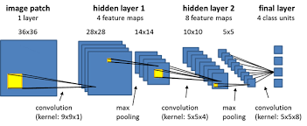
Proposed solution
Algorithm
CNN (Convolutional neural network) is a deep learning networking architecture that learns directly from data.
This is considered as the most effective algorithm for image classification, retrieval, and detection tasks.

Slide 9
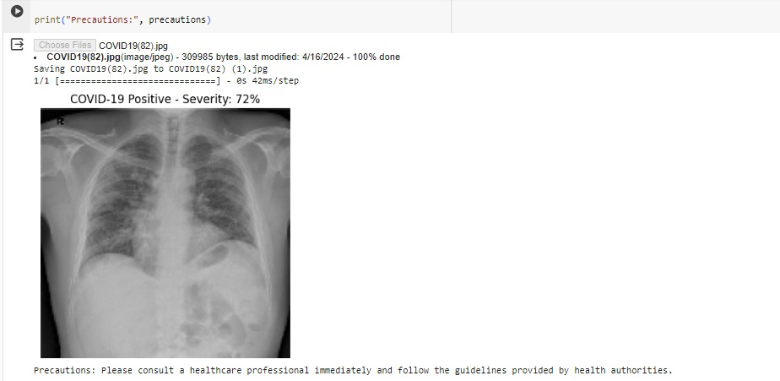
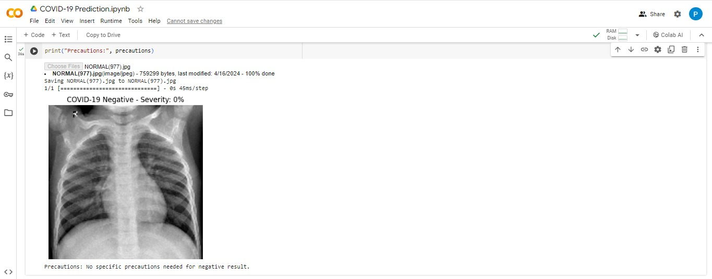
Results

Slide 10
Future Scope
There are those who contract the virus for the first time and those who continue to experience symptoms even years of infection.
This project can even further be developed when they are any new symptoms traced or any similar kind of pandemic emerges.

Slide 11
References
https://ieeexplore.ieee.org/document/9716478
https://www.ncbi.nlm.nih.gov/pmc/articles/PMC8286881/
https://www.datacamp.com/tutorial/introduction-to-convolutional-neural-networks-cnns>
https://www.kaggle.com/datasets?search=covid+-19

Slide 12
THANK YOU
.

